Slide 1
Predictive Analytics: NBA Player Salaries
Date: 7/14/2020
By: Ngo, Tai
Nguyen-Duong, Thanh

Slide 2
Objectives and Background Information
Using predictive analytics and players’ performance statistics to predict players’ salary and help teams build the most optimal roster
Teams in the National Basketball Association (NBA) wants to use their budget efficiently to evaluate and pay for the players’ performance accordingly.
Building a roster that consists of undervalued players optimizes the budget’s usage and achieves the highest possible result.

Slide 3
Methods
Phase 1: Perform Exploratory Data Analysis (EDA) to explore the NBA dataset - 52 variables will be examined.
Phase 2: Perform Feature Selection by using different techniques from random forest classifier, recursive feature elimination, extra trees classifier, chi-squared analysis and Lasso regression. The feature scores are used to determine the feature rankings.
Phase 3: Build the predictive model, run the model and summarize the results

Slide 4
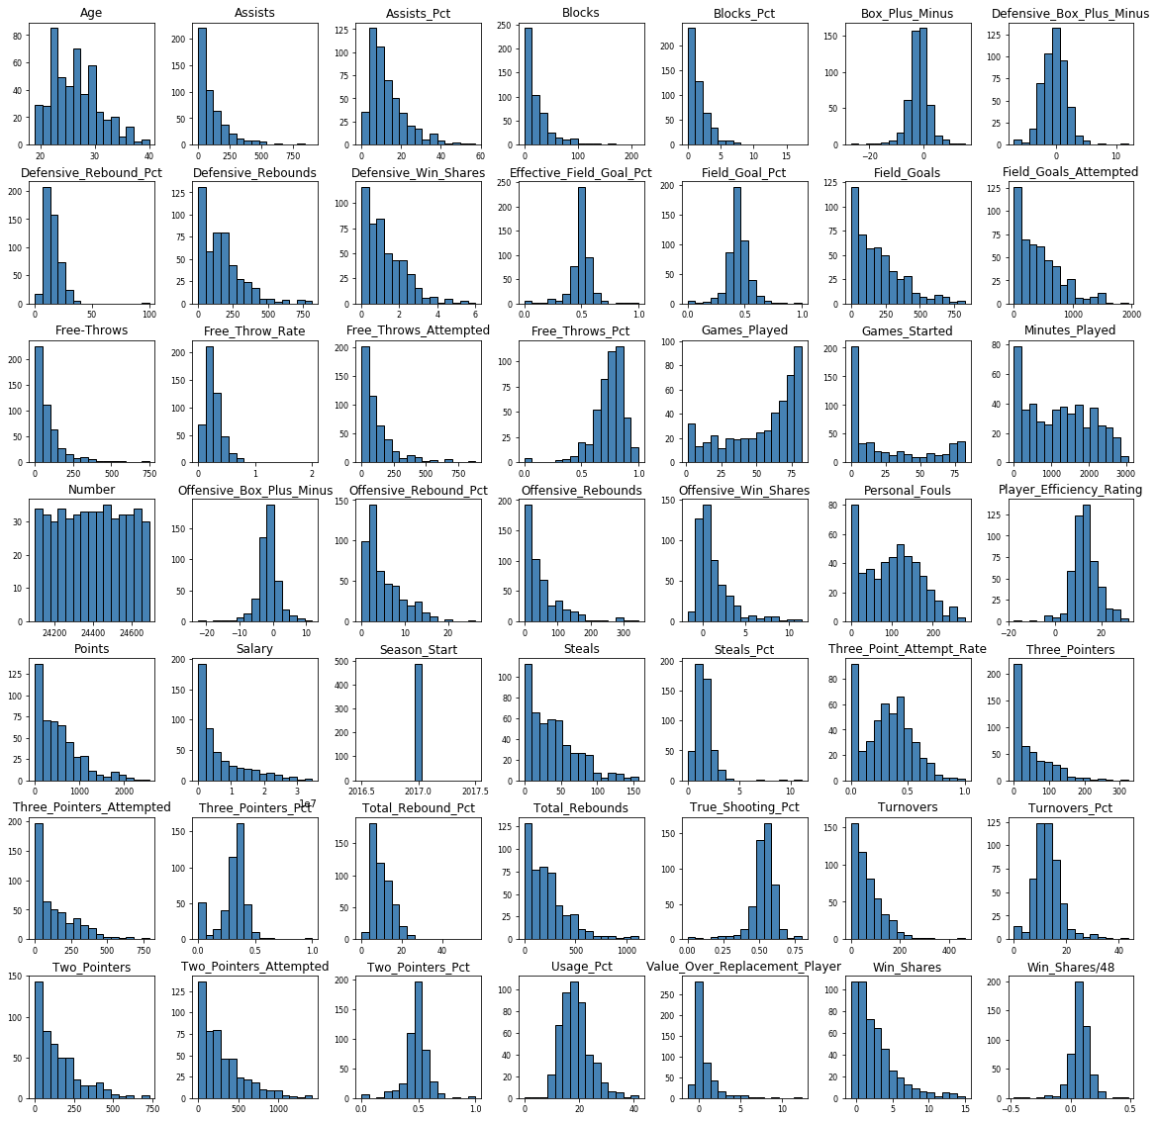
Phase 1: Exploratory Data Analysis
Draw a histogram for all 52 variables
Find and collect the variables with a
normal distribution

Slide 5
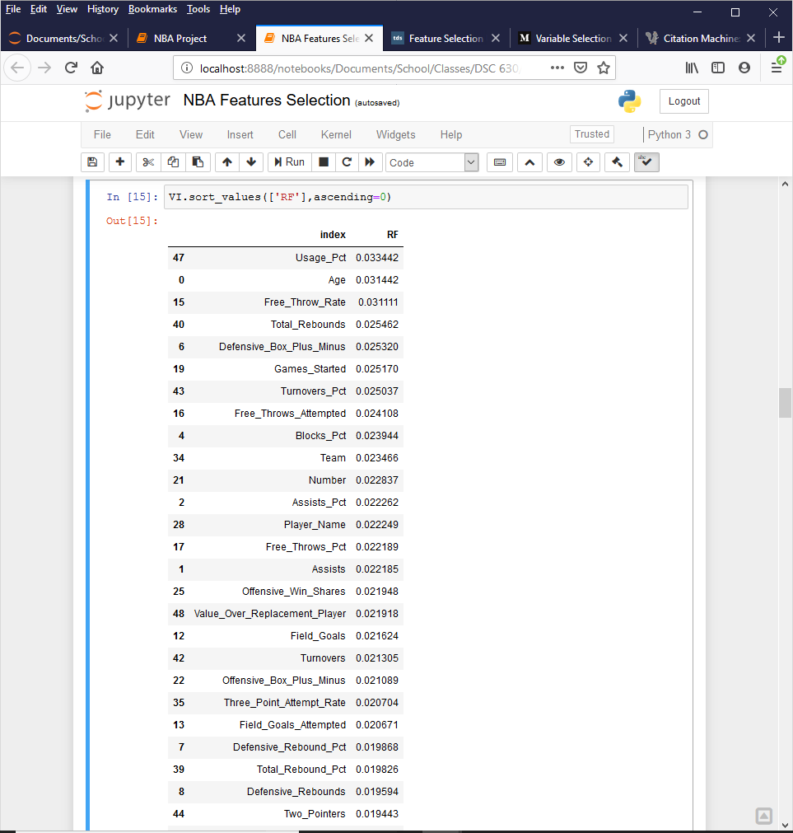
Phase 2: Feature Selection
Technique used: Random Forest Classifier
A part of the output from Random Forest
variable importance calculation is shown.
Each feature is given a score based on its
importance to the model.

Slide 6
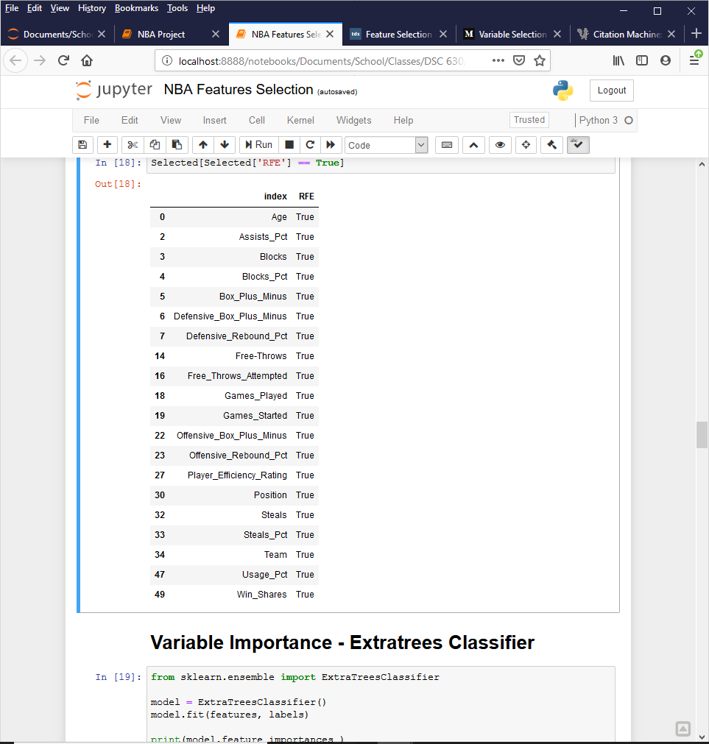
Phase 2: Feature Selection
Technique used: Recursive Feature Elimination (RFE)
RFE: a backward selection of predictors
RFE: builds a model based on the entire set of
Predictors and computes a score for each predictor
If RFE is “True” for a particular feature, then the
feature is not eliminated.

Slide 7
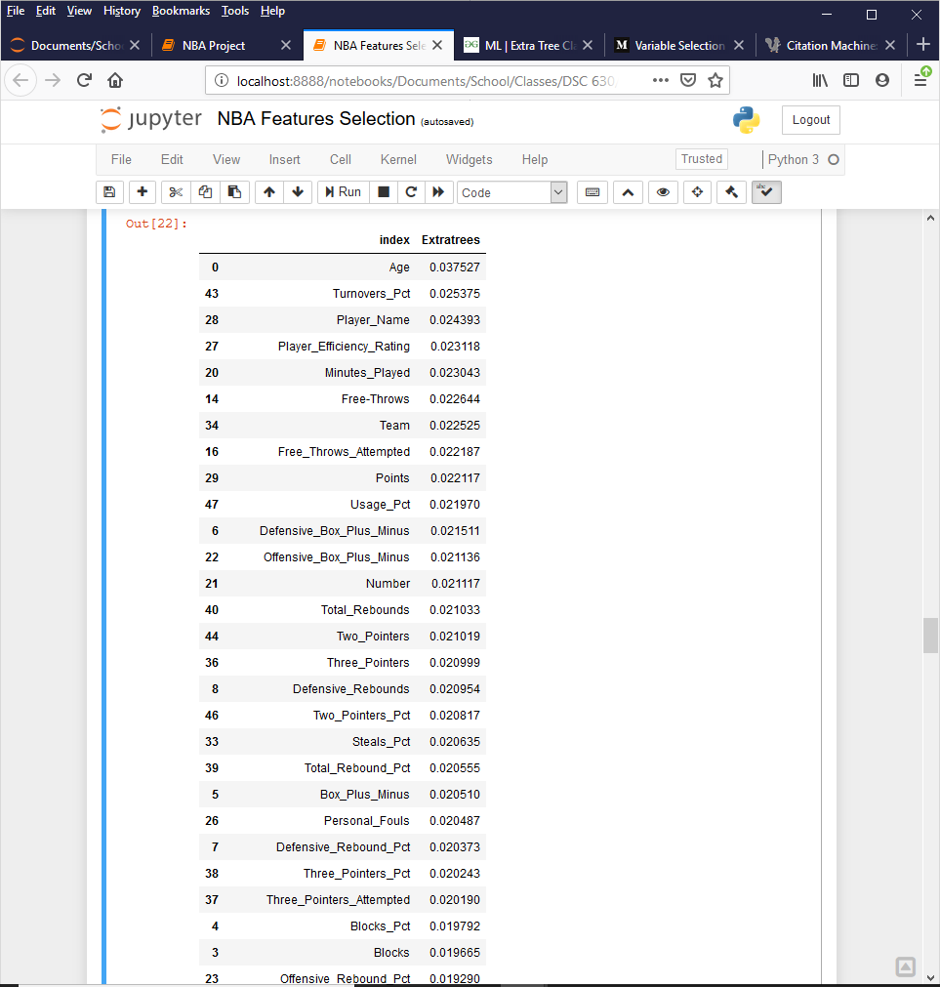
Phase 2: Feature Selection
Technique used: Extra Trees Classifier
Extra trees classifier is similar to random
forest classifier.
In this classifier, a decision tree is constructed
Each test node provides a random sample of
K features.

Slide 8
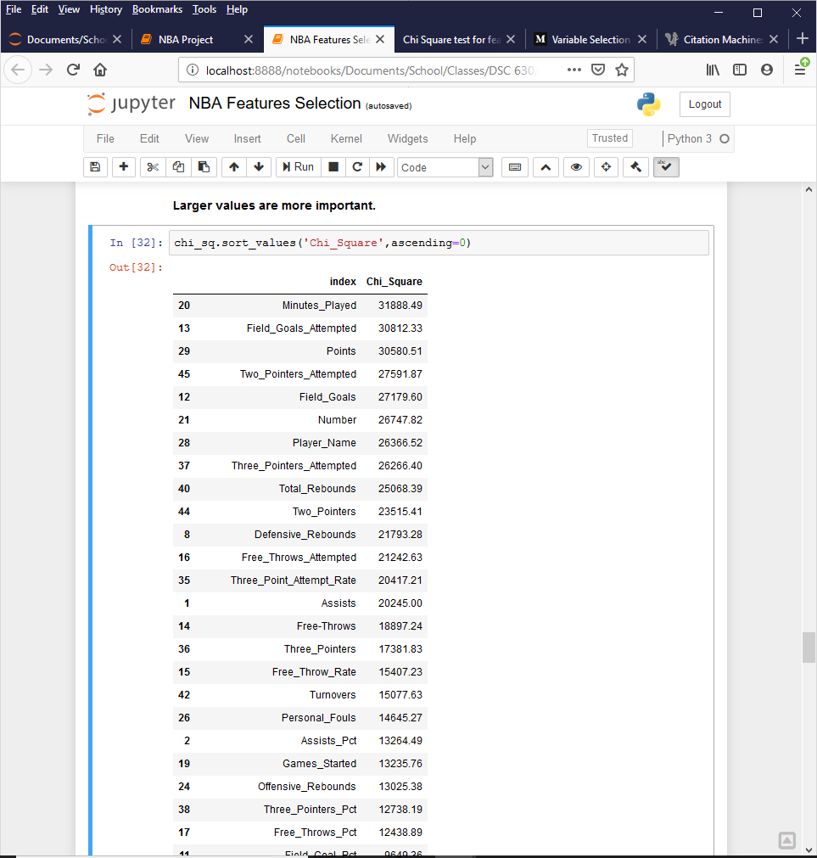
Phase 2: Feature Selection
Technique used: Chi-Square
Chi-square test checks the independence
of two events.
When two events are independent,
the chi-square score is small.
The high score indicates the higher likelihood
of having features correlated with the class.

Slide 9
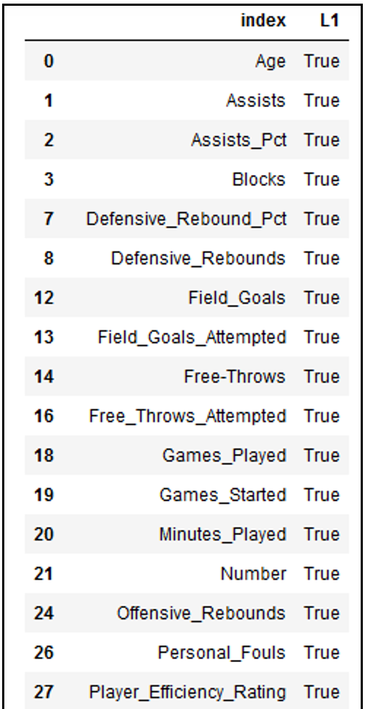
Phase 2: Feature Selection
Technique used: Lasso Regression
Lasso regression can shrink the coefficients, that
multiply with the predictors, to zero; this ability
helps remove the features from the model.
Lasso regression helps modelers deal with the
problem of regularization.

Slide 10
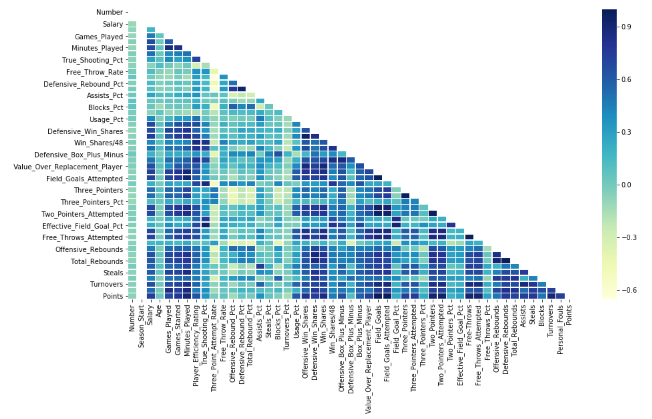
Phase 2: Feature Selection
Confusion Matrix: test the correlations
among the features
Features associated with “attempted”
are removed.

Slide 11
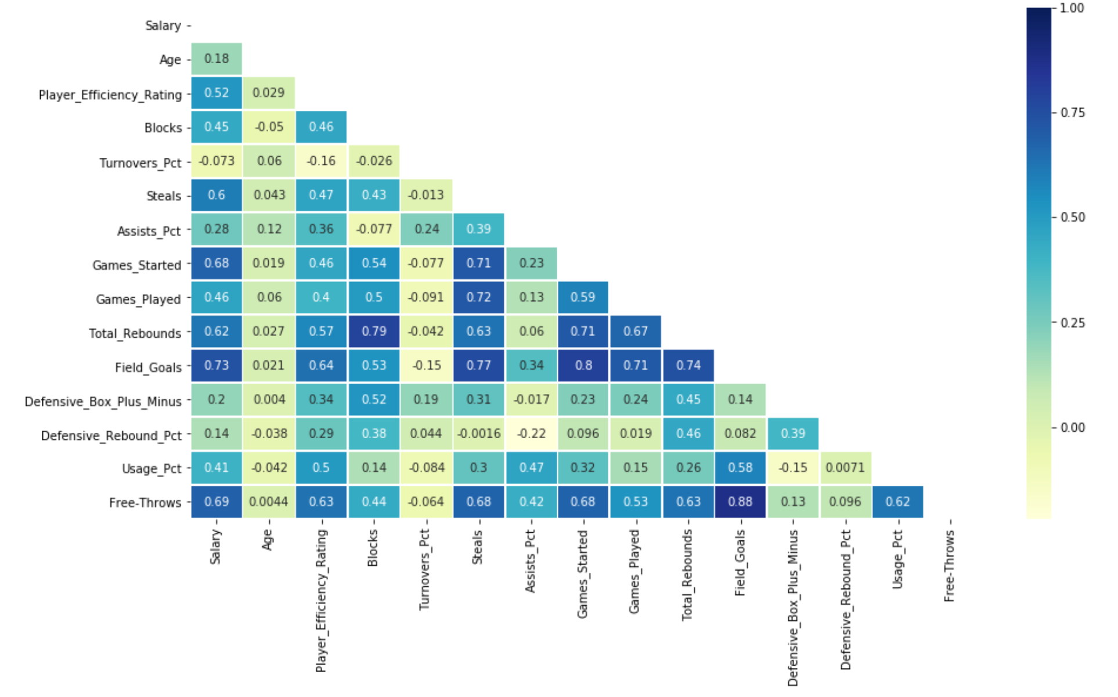
Phase 2: Feature Selection
Confusion Matrix: re-draw after
removing unnecessary features

Slide 12
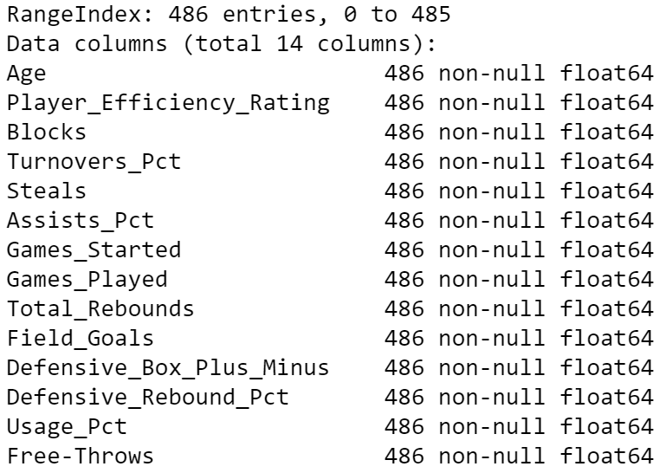
Phase 3: Feature Finalization and Model Build
Out of 52 variables, 14 variables are
selected as features to make prediction.
The target variable is the Salary.

Slide 13
Predictive Model 1: Random Forest Classifier
Method:
Use 14 selected features to train the model
Choose Salary as the target variable
Use RandomForestClassifier() to fit model the train data
Predict and check the result with the coefficient of determination and the explained variance regression score
Results:
Coefficient of determination = 0.35
Mean squared error = 0.41
The bar graph allows us to see which players are overpaid and underpaid.

Slide 14
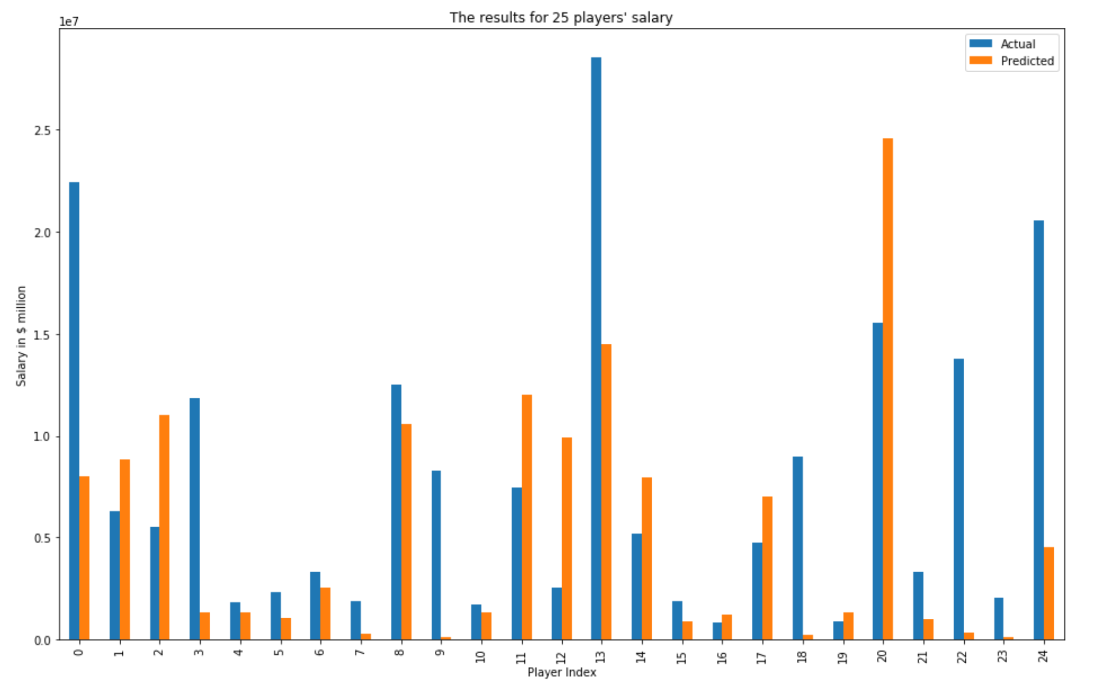
Predictive Model 1: Random Forest Classifier

Slide 15
Predictive Model 2: Linear Regression
Method:
Use 14 selected features to train the model
Choose Salary as the target variable
Use LinearRegression() to fit model the train data
Predict and check the result with the coefficient of determination and the explained variance regression score
Results:
Coefficient of determination = 0.52
Mean squared error = 0.52
The bar graph shows the data for 25 players to predict who are overpaid and underpaid.

Slide 16
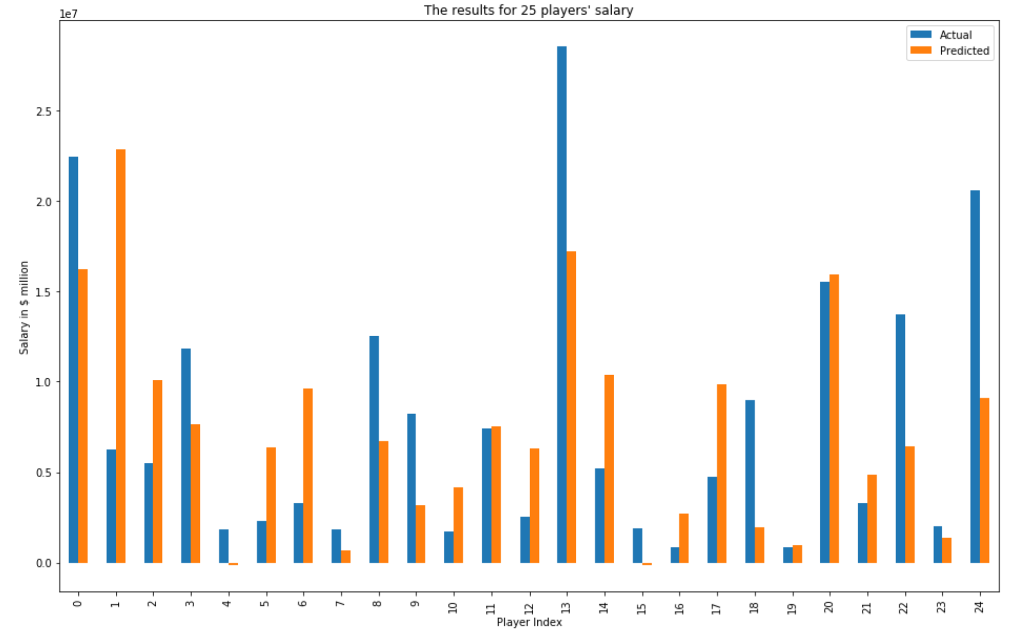
Predictive Model 2: Linear Regression

Slide 17
Challenges and Difficulties
During feature selection process, we have to research more about basketball teams to understand what characteristics coaches prioritize.
Many features have high correlation, which makes the elimination process become more random.
We have reduced from 52 variables down to 14 variables. It increases the chance of eliminating the right features.
Since we had a very low score initially by using wrong scoring methods, we had to learn how to assess model accuracy properly with the right methods.

Slide 18
Future Plans
We will continue to try out more machine learning models and fine-tune the parameters to achieve higher score.
Since we have about 400 players, we are trying to show actual and predicted results for all players within a graph. In this presentation, we have shown 25 players’ salary.
Add the player names back to the dataframe so that we can see which players are overpaid and which ones are underpaid
Draft the dialogue we will use for the final presentation
We will continue to work on the remaining of the project.

